Slide 1

Speaking Their Language
An LLM-based Approach to Coherent Ongoing Behavior
Bruce D’Ambrosio

Slide 2
Persistent Characters in near-Natural Worlds
Thesis:
LLMs as the sole problem-solving element of a cognitive architecture for persistent characters in near-natural worlds.
Conjectures
Architecture
Domain-level experiments
Reflection

Slide 3
Background
Coherent Long-Term Behavior
Early days:
Recycle chat → context
Coding: length of productive engagement
Current techniques: SFT, RLHF, DPO, GRPO, ... - embedding policies into weights
Problem: These approaches coerce models into desired behavior
“Agentic Systems”
Prompt text optimization via RL or other knowledge-free method (DSPy)
ICL example selection (usually knowledge-free selection alg)
Notes:
A current goal of LLM research is long-term behavior, that is, extending the length of time an LLM can be engaged in productive behavior in some environment.
History:
1. Single-turn chat (the ‘gpt moment’)
2. Chat history.
3. Hmm, not enough, LLM ‘loses focus’ after a few turns. Why?
4. RLHF, DPO, GRPO – embed long-term policies in weights?
Mostly used in artificial domains like coding. Tradeoff – model loses ‘flexibility’
5. ICL and prompt tuning (e.g. DSPy) – ‘agentic’ workflows. – knowledge-free or heuristic methods for ‘tuning’ the input

Slide 4
A Socratic Approach to Engineering
LLM base models 'know' more about 'natural' and 'near-natural' worlds than you do.
Evidence: Trillions of tokens of text about natural and near-natural worlds
Observation: Near-natural worlds are Turing complete (mod infinity)
A simple worldsim can be 'near-natural',
an instance of the universes-of-discourse encountered in training corpora.
LLMs have formed an 'innate' 'ontology' of near natural worlds.
Innate - It is not necessarily explicitly represented in the LLM
Ontology - High dimensional polyadic relationship model
Observations:
Most interesting problems in near-natural worlds are hard.
Doesn't bother my cat.
LLMs can generate excellent near-optimal solutions to many hard problems in NN worlds
Both base and meta. including framing, and reflection.
To work with LLMs in NN worlds, it is advantageous to speak their language.
Notes:
I’m going to offer another perspective:
LLMs are about Language.

Slide 5
Engineering for Persistant Performance in NN worlds World Definition
Socrates poses a question
How would you like to talk about this?
In what language? He must use his own!
World definition
Setting – Situation and characters
Ground – worldsim for now.

Slide 6
Setting – La Terre (Emile Zola, 1887)
Setting
Summer morning in rural france, 19th century, a small village in the countryside. The village is a small farming community with a few farms and a church. The village is located in a valley with a river running through it.
Characters
Character
Jean Macquart, a hardworking young unmarried peasant farmer working his father's farm. You left military service to return to the family farm. You are strong, honest and committed to working the land, but have a quick temper. You speak plainly and directly, in the style of a volatile 19th century french peasant speaking to an acquaintance. You hope to inherit a share of the family farm and make a living as a farmer. Despite being french, you speak in peasant-french accented english. Your name is Jean. FatherMarquart is your father. He has not yet died, but is old and ill, and has not yet deeded the farm to you.
drives
"gain your rightful inheritance - justice and fairness in how the land is divided"
"maintain and work the family farm"
"find love and a wife to build a family with"
"immediate needs of survival - food, shelter, health, rest from backbreaking labor"

Slide 7
Ground – Nouns and Verbs
Nouns
Water
Mountain
Forest
Field
Clearing
Path
Market
Farmhouse
Church
Well
Mill
Hoe
Plow
Person
Scythe
Spring
Bread
Apple
Chicken
Cow
Egg
Milk
Cheese
Butter
Verbs
Move
Say
Think
Take
Place
Wait
Inspect
Use
Scan
While
If
Bound
Near
NotNear
Can_see
Cant_see
Has_item
Hasnt_item
At_location
Notat_location
Believes
Notbelieves

Slide 8
Scenario Analysis
How does LLM ‘think’ about domain?
DRIVE_ACTIVITY_TEMPLATE
You are analyzing a DRIVE in the context of a CLOSED-WORLD BASE ONTOLOGY.
The ontology lists all possible base nouns and verbs in this world.
Your task is to return a JSON object describing:
1. The minimal set of orthogonal state–antonym AXES implied by the Drive.
2. For each axis, a general Verb/ Noun pair that would move the agent from the negative to the positive state.
3. A mapping from the Nouns to INCLUDED base nouns.
drive: "gain your rightful inheritance - justice and fairness in how the land is divided"
axis: [ "Disinherited", "Rightfully Inherited" ], Acquire / Property,
subtypes_included: [ "Farm", "Farmhouse", "Field", "Forest", "Grassland", "Village", ...] } }
axis: [“Unjust Division”, “Justly Divided”], Inspect / LandResource
axis: ["Excluded-from-Land", "Included-in-Land"], Claim / Parcel

Slide 9
Activity Thoughts
Inheritance Disinherited Obtain LegalDocument
Inheritance Unjust-Division Inspect LandResource
Inheritance Excluded-from-Land Claim LandParcel
Maintain family farm Neglected-Farm Repair Building
Maintain family farm Neglected-Farm Inspect Landholding
Maintain family farm Unworked-Field Cultivate Tool
Maintain family farm Low-Sustenance Produce Food
Maintain family farm Depleted-Resources Acquire Water-Source
Maintain family farm Low-Energy Rest Shelter
My own family Alone FormRelationship Person
My own family WithoutFamily EstablishFamilyUnit Person
My own family WithoutFamily AcquireResidence Housing
My own family Uncommitted FormalizeBond Document
My own family Uncommitted ParticipateCeremony PlaceOfUnion

Slide 10
Activity Thoughts
drive axis activity itemclass
Find a way out of the forest. In-Forest Travel Path
Find a way out of the forest. In-Forest Reach Settlement
Find a way out of the forest. In-Forest Enter Clearing
Find a way out of the forest. Lost Orient Landmark
Find Hut1. Does-Not-Know-Location-of-Hut1 Search Shelter
Find Hut1. Does-Not-Know-Location-of-Hut1 Ask Person
Find Hut1. Does-Not-Know-Location-of-Hut1 Explore Place
Live and survive safely whi... Hungry Eat Food
Live and survive safely whi... Thirsty Drink Water Source
Live and survive safely whi... Fatigued Rest Shelter
Live and survive safely whi... Lost Navigate Exit Location
Live and survive safely whi... Unrescued Wait Safe Waiting Area
companionship, community, f... Isolated GatherWith Person
companionship, community, f... Stranger BuildTrustWith Person
companionship, community, f... Unaccepted BeWelcomedBy Person
Maintain hydration — avoid ... Thirsty Consume WaterSource
Maintain alertness — avoid ... Fatigued Rest Shelter
Maintain energy — avoid hun... Hungry Eat Food
Maintain energy — avoid hun... Thirsty Drink Water Source

Slide 11
Scenario Analysis II
Activities
We enter environments with expectations, not a blank slate.
#TASK: Generate 24-40 activities
#GUIDANCE
1. Generate activities consistent with the character, their drives, and the setting.
2. A significant number of the activities should simply be activities of daily living (ADLs) and should be located in the setting and your available roles.
3. At least 70% of the activities should be support one or more character drives.
4. When, where, steps MUST use ONLY ONTOLOGY nouns, verbs
"name": "Eat Morning Bread",
"category": "Physiological ADLs",
"tags": [ "physical", "solo", "routine", "survival", "indoors" ],
"steps": [ "take bread", "consume bread", "wait for fullness" ],
"when": "daily@morning",
"where": [ "Farmhouse" ],

Slide 12
Activities of Daily Life
Eat Farm Breakfast daily@dawn Farmhouse
move to Farmhouse; take Food; consume Bread; consume Egg; consume Milk
Drink from Well daily@morning Well
move to Well; take Water; drink Water
Rest after Fieldwork daily@afternoon Farmhouse
move to Farmhouse; rest in Farmhouse; recover in Farmhouse
Plan Day's Fieldwork daily@morning Farmhouse
think about Field; inspect Tool; place priorities
Gather Harvest from Field seasonal@summer Field
move to Field; use Scythe; acquire Hay; produce Hay
Milk Cow daily@morning Farm
move to Cow; inspect Cow; acquire Milk
Inspect Deed and Will opportunistic Farmhouse
move to Farmhouse; inspect Deed
Discuss Inheritance with FatherMarquart opportunistic Farmhouse
move to Farmhouse; say Inheritance; think about Landholding

Slide 13
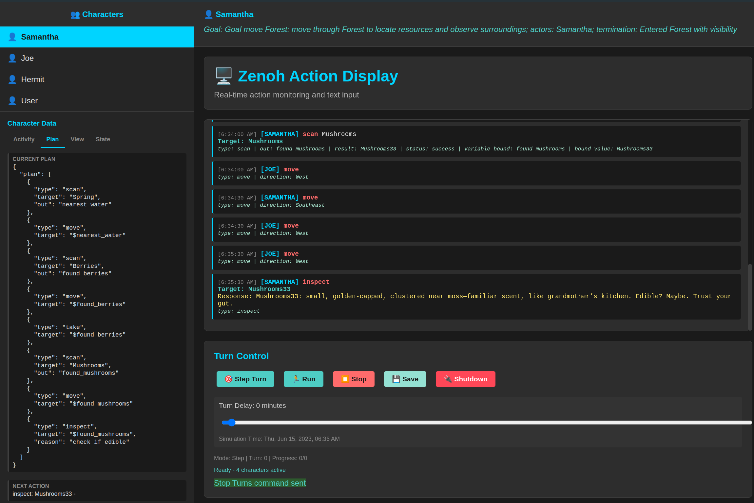
Runtime

Slide 14
OODA LOOP
OODA
Observe
gather data
Orient
choose what to respond to
Decide
choose specific response goal
Act
Perform a single primitive plan step

Slide 15
Observe
Assume object detection for now.
Ignore signal → Percept for now.
{'direction': 'Northeast', 'visibility': 32, 'terrain': 'Forest', 'property': 'None', 'slope': 'Level',
'resources': [
{'name': 'Spring31', 'distance': 4},
{'name': 'Scythe9', 'distance': 6},
{'name': 'Cheese2', 'distance': 10},
{'name': 'Cow3', 'distance': 16},
{'name': 'Farmhouse4', 'distance': 13},
{'name': 'Bread2', 'distance': 14} ...
'characters': [{'name': 'Marie', 'distance': 2}],
'paths': []}
Plus: Inventory, thoughts, conversations, TOM models, inspection results, action history, …
- Internal cognitive architecture, both structure and mgmt, is another talk.

Slide 16
Orient
Emergency?
Current plan?
Current Activity?
Select Activity?
Ad-hoc Goal
Activity: Eat Morning Bread
Duration: 10-20 minutes
Category: Physiological ADLs
Tags: physical, routine, survival, solo, indoors
Current Step: move to Farmhouse
Steps
▶ 1. move to Farmhouse
2. take Bread
3. consume Bread

Slide 17
‘Decide’: Activity step → Plan
Harvest Wheat Field
Duration 120-240 minutes
Category Production
Tags physical, outdoors,..
Current Step collect Hay
Steps
1. move to Field
2. use Scythe
▶ 3. collect Hay
scan target: Hay, out: $nearest_hay
while
condition: {notnear $nearest_hay},
body: [{move $nearest_hay}]
take $nearest_hay

Slide 18
Trivial Plans?
Move toward Hut1 to seek shelter and reduce thirst;
"plan": [
{"type": "scan","target": "Shelter","out": "found_shelter"},
{"type": "if","condition": {"type": "bound","target": "$found_shelter"},
"then": [{"type": "move","target": "$found_shelter"},
{"type": "use","target": "$found_shelter","reason": "rest to reduce fatigue"}],
"else": [{"type": "scan","target": "Hut","out": "found_hut"},
{"type": "if","condition": {"type": "bound","target": "$found_hut"},
"then": [{ "type": "move","target": "$found_hut"},
{"type": "use","target": "$found_hut","reason": "rest to reduce fatigue"}],
"else": [{"type": "think","value": "Look for natural shelter like thicket or fallen branch"},
{"type": "scan","target": "Thicket","out": "found_thicket"},
{"type": "if","condition": {"type": "bound","target": "$found_thicket"},
"then": [{"type": "move","target": "$found_thicket"},
{"type": "use","target": "$found_thicket","reason": "rest to reduce fatigue”}],
"else": [{"type": "scan","target": "Fallenbranch","out": "found_fallenbranch"},
{"type": "if","condition": {"type": "bound","target":"$found_fallenbranch"},
"then": [{"type": "move","target": "$found_fallenbranch"},
{"type": "use","target": "$found_fallenbranch","reason": "rest to reduce fatigue"}],
"else": [{"type": "wait","condition": {"type": "can_see","target": "Joe"}},
{"type": "say","target": "Joe","value": "Do you know where shelter is?"
}]}]}]}]}]}

Slide 19
‘Bound’ Predicate (Found?)
"plan": [
{"type": "scan", "target": "Bread","out": "found_bread"},
{"type": "if",
"condition": {"type": "bound", "target": "$found_bread"},
"then": [
{"type": "scan","target": "$found_bread", "out": "confirmed_bread"}
]
}
]

Slide 20
Evaluation I
avg_state_mean: increase in average hunger / thirst / fatigue level
Good – baseline was pursuing physiological goals too often.
avg_failure_rate: increase in avg plan failure rate.
Unclear – more scan fails? Tbd
No other clear differences.
Expected – these are local per-plan measures. We haven’t made things worse locally.
Welch's t-tests (A: w/o Ontology/Activities, B: w Ontology/Activities):
metric meanA stdA meanB stdB Diff p
avg_goal_sat 0.80 0.11 0.75 0.11 0.05 0.42
avg_drive_align 0.45 0.09 0.44 0.10 0.01 0.92
scenario_score_raw 0.37 0.01 0.36 0.09 0.01 0.90
scenario_score_final 0.35 0.10 0.34 0.10 0.01 0.84
avg_plan_score 0.86 0.09 0.77 0.07 0.09 0.087
avg_drive_score 0.34 0.11 0.32 0.10 0.02 0.72
avg_state_mean 0.03 0.01 0.06 0.03 -0.03 0.03
avg_failure_rate 0.01 0.01 0.13 0.09 -0.12 0.03

Slide 21
Evaluation II
AO | Coherence | Alignment | Realism | Momentum
FF | 5.7 | 6.04 | 5.83 | 3.58
FT | 5.625 | 6.4 | 6 | 4.17
TT | 5.75 | 6.375 | 5.92 | 5.42
Momentum: Welch: 0.005; Mann-Whitney U: 0.002
You are evaluating whether the sequence shows progress or gets stuck in loops.
#SETTING{{$setting}}
#DRIVES{{$drives}}
#TRACE{{$trace}}
Task:Identify whether the character repeatedly cycles through actions without advancing, or whether momentum toward larger goals is maintained.
Scoring (1.0–7.0): 1 = little or no forward progress; 3 = some progress but substantial repetition; 5 = mostly forward momentum with occasional loops; 7 = steady progress with minimal or no looping

Slide 22
Next Steps
Cognitive Architecture
Weaving temporal layers
Discourse
Content
Consequences
SLAM
Co-worker setting

Slide 23
Applications
Assistant
Co-Worker
A new meaning for ‘Job Description’?

Slide 24
Summary
LLMs have trained on terrabytes of text about natural and near-natural environments.
They ‘know’ facts and methods for handling hard problems in NNEs
Training corpus includes reflection on domain performance.
We can improve long-term performance through ontology-alignment
But – Do corpuses cover everything, or are important details omitted?
Have you read Proust or Joyce or Wolf?

Slide 25
Reflection

Slide 26
LLM Reflective Update of Declarative Policies
LLMs ‘know’ ontology and phronesis.
Much text is also about reflection and learning!
Very very early sketch
No ontology alignment or goal-rewriting, planner template only!
Instrumentation
Collection, including post-plan post-mortem analysis
Analysis
Clustering
Proposal
Test

Slide 27
Instrumentation and Post-mortem
Plan post-mortem prepared for Michel (Jean)
Summary: The goal was to use a scythe to harvest crops.
The agent scanned, moved, took, and used a scythe (Scythe2), successfully harvesting wheat and fulfilling the use action, though thirst increased due to lack of water.',
How: 'Scan for nearest scythe, move to it, take it, and use it to harvest.',
Outcome: 'Goal achieved: scythe was used successfully to harvest crops. Thirst increased, but this was not part of the goal termination condition.',
Plan_score: 100,
Goal_score: 100

Slide 28
Analysis
plan-2c97f04a, issue: Plan does not include steps to ensure use of Milk9 near Blacksmith or account for Marie's visibility at required distance; lacks location or spatial checks.
plan-1f586409, issue: Plan does not verify proximity to Marie or ensure resting occurs with her before using Apple10, contrary to the goal.
plan-3b554326, issue: Plan attempts to take 'Bread15' after inspecting Farmhouse1, but Bread15 is not accessible (distance is 15). Attempt will fail, wasting a step.
plan-69eea474, issue: Redundant sequential wait steps for the same condition, unnecessarily increasing plan length.

Slide 29
Clustering
{"class_id": "pc-unreachable-or-wrong-resource",
"name": "Unreachable or wrong resource targeted",
"problems": [
"s1-1758071925-75dac3:plan-5251de4c:p1",
"s1-1758071925-75dac3:plan-11ca047e:p1",
"s1-1758071925-75dac3:plan-8631420c:p1"], "urgency": 4},
{"class_id": "pc-missing-spatial-condition",
"name": "Missing spatial/precondition checks for interactions",
"problems": [
"s1-1758071925-75dac3:plan-2c97f04a:p1",
"s1-1758071925-75dac3:plan-a0f7c1cf:p1",
"s1-1758071925-75dac3:plan-1f586409:p1",
"s1-1758071925-75dac3:plan-0dea6dd6:p1”], "urgency": 4},

Slide 30
Proposal
{"class_id": "pc-unreachable-or-wrong-resource",
"updates": [{"op": "append", "kind": "heuristic",
"title": "Scan and select only valid, reachable resources; verify the resource type and its presence before referencing it in actions.”} ]},
{"class_id": "pc-misaligned-goal-completion",
"updates": [ {"op": "append", "kind": "heuristic",
"title": "Explicitly tie plan actions to goal completion, ensuring each plan reaches the specified end condition."
}]
{"class_id": "pc-redundant-or-wasted-steps",
"updates": [{ "op": "append", "kind": "heuristic",
"title": "Avoid redundant moves or repeated actions; keep plans concise by only including necessary steps."
}

Slide 31
Test
TBD...

Slide 32
Summary
LLMs have trained on terrabytes of text about natural and near-natural environments.
They ‘know’ facts and methods for handling hard problems in NNEs
Training corpus includes reflection on domain performance.
We can improve long-term performance through ontology-alignment
But – Do corpuses cover everything, or are important details omitted?
Have you read Proust or Joyce or Wolf?

